Slide 1

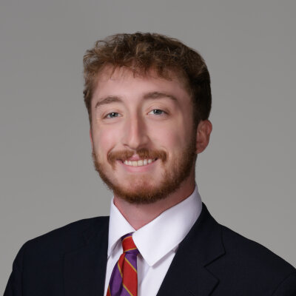
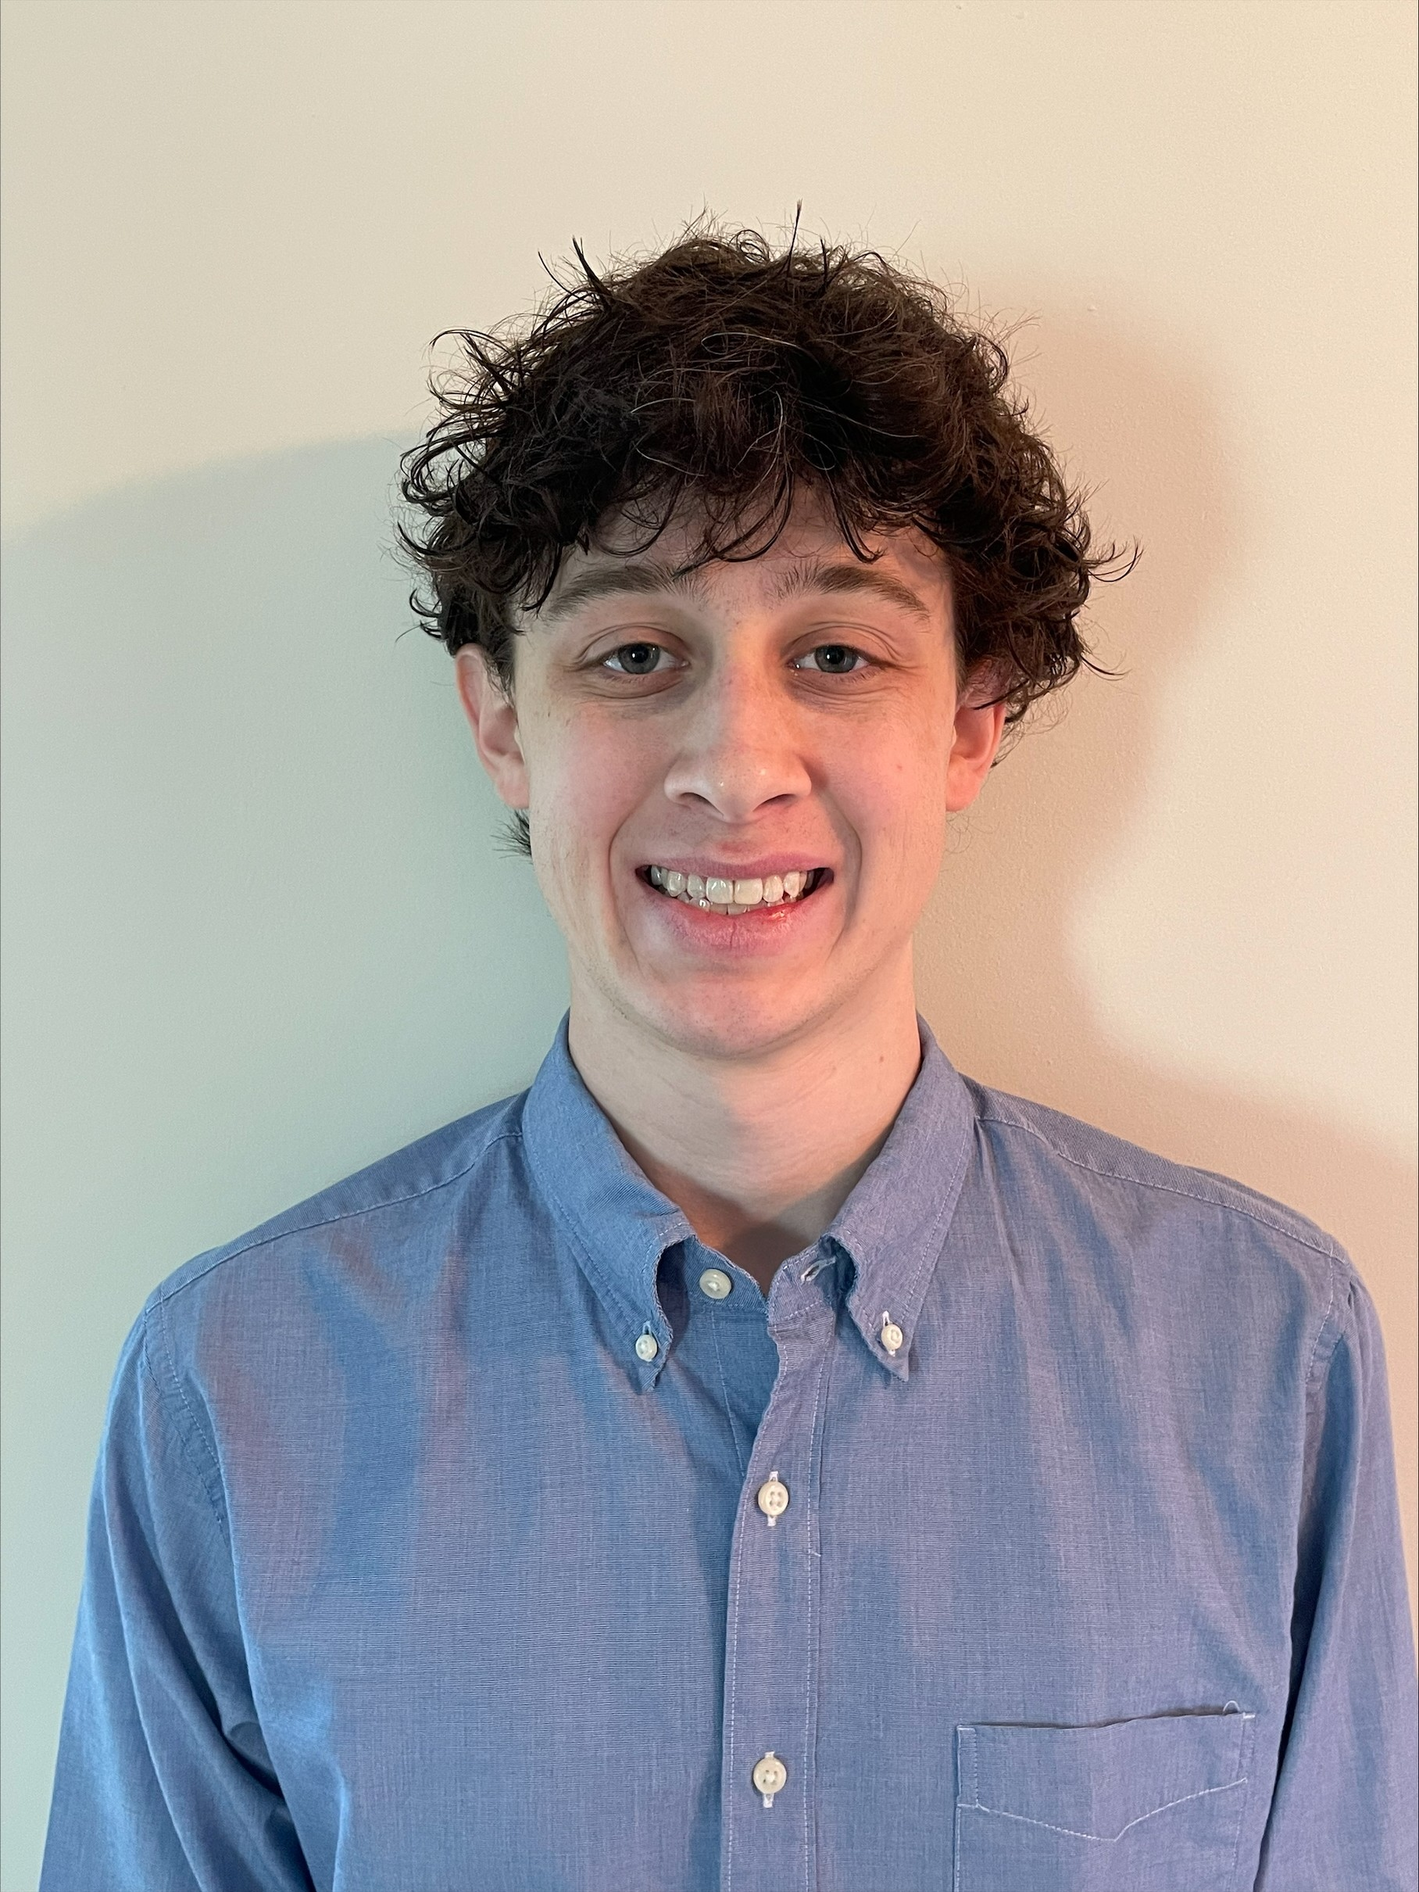

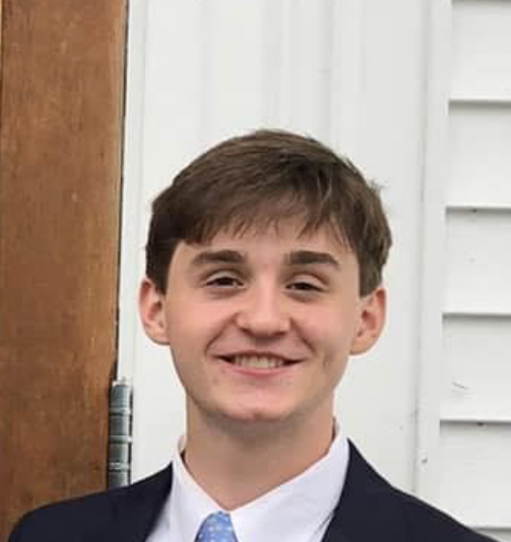

SmartGlass Analytics – Sprint 3 …
Project Website
Gabe Gros
Chris Hellen
Ethan Schwalbach
github repo
Aiden Carroll
Kendall Hamm

Slide 2
Project Focus
Build third party app on host tablet to keep up with stats from provided API
Enable user of tablet to display whatever stats they prefer to see at that time on smart glasses

Slide 3

Functionality Implemented
Android App
Contains player cards with live stats
Multi-select stats to send to glasses
Utilize Synergy API
Allows for live, in game, updates to statistics
Smartglass display
Show selected stats on Frames
Experiencing issues with execution from app

Slide 4
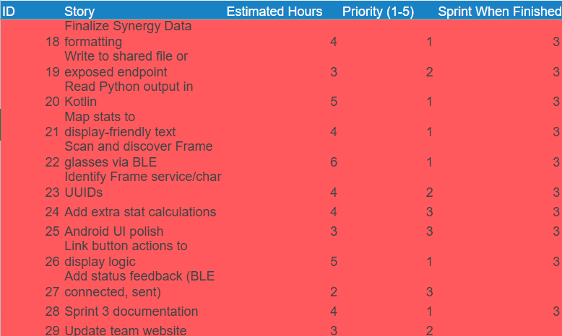
Project & Sprint Backlog

Slide 5
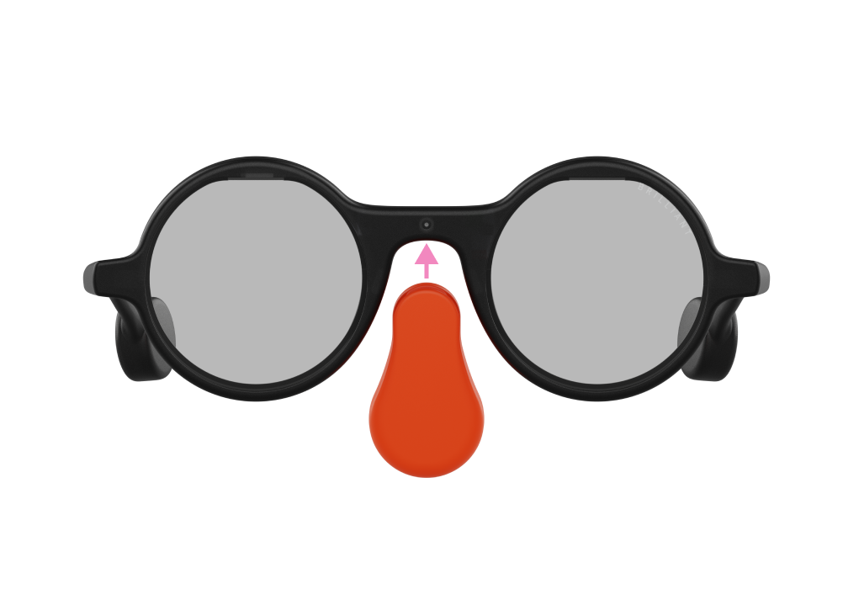
Significant Backlog Items
Achieved
Upgraded Android app UI with more features
Synergy API integration to retrieve real statistics
Import full roster along with calculated advanced statistics
Connect to Frame SmartGlasses from app
Still Working
Display selected statistics on Frame SmartGlasses
Can connect to glasses via bluetooth and send commands, but are unable to see the command executed on the Frame

Slide 6
Live Demo

